Slide 1
Klasifikasi Ruangan di Gedung Pascasarjana PENS
Anggota Kelompok:
Silfiana Nur Hamida (1223800005)
Ambarwati Rizkia Putri (1123800008)
Firnanda Pristiana Nurmaida (1122800004)
Mochamad Riswandha Lazuardi (1123800006)

Slide 2
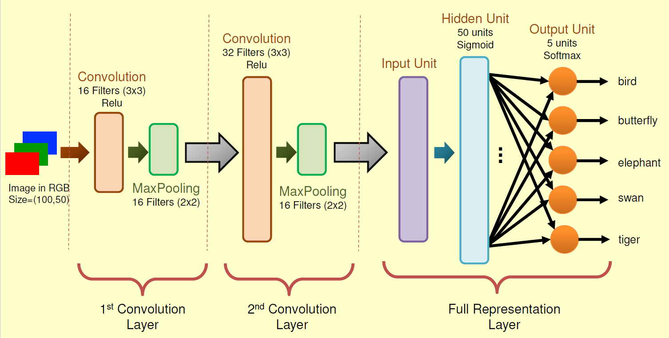
Pendahuluan
Lift
Tangga
Koridor
Toilet
Pintu
Darurat

Slide 3
Melakukan Klasifikasi Gambar
Gambar diklasifikasikan dalam 6 macam, yaitu:
Lift
Tangga
Koridor
Buntu
Toilet
Pintu Darurat
Semua gambar yang didapatkan kemudian dibagi menjadi tiga
bagian, yaitu data training, validation, dan test.

Slide 4
Code
Membuka direktori
%cd /content/drive/MyDrive/CNN_Image4_5
Membaca folder dataset
import os
base_dir = "/content/drive/MyDrive/CNN_Image4_5/dataset"
train_dir = os.path.join(base_dir, 'train')
validation_dir = os.path.join(base_dir, 'validation')
test_dir = os.path.join(base_dir, 'test')
folders=os.listdir(train_dir)

Slide 5
Melakukan preprocessing gambar dengan menggunakan ImageDataGenerator
from tensorflow.keras.preprocessing.image import ImageDataGenerator
train_datagen = ImageDataGenerator(rescale=1./255)
val_datagen = ImageDataGenerator(rescale=1./255)
train_generator = train_datagen.flow_from_directory(
train_dir,
target_size=(100, 50),
batch_size=1)
validation_generator = val_datagen.flow_from_directory(
validation_dir,
target_size=(100, 50),
batch_size=1)

Slide 6
Melakukan Identifikasi class train dan class validation
class_names_train = train_generator.class_indices
class_names_validation = validation_generator.class_indices
print("Nama Kelas Train:", class_names_train)
print("Nama Kelas Validation:", class_names_validation)
Menggunakan keras dan import layers dan model
from tensorflow.keras import layers
from tensorflow.keras import Model
img_input = layers.Input(shape=(100, 50, 3))
x = layers.Conv2D(16, 3, activation='relu')(img_input)
x = layers.MaxPooling2D(2)(x)
x = layers.Conv2D(32, 3, activation='relu')(x)
x = layers.MaxPooling2D(2)(x)
x = layers.Flatten()(x)
x = layers.Dense(50, activation='sigmoid')(x)
output = layers.Dense(5, activation='softmax')(x)
model = Model(img_input, output)
model.compile(loss='mean_squared_error', optimizer='SGD', metrics=['acc'])

Slide 7
Melakukan training data dengan 100 iterasi
history = model.fit_generator(
train_generator,
steps_per_epoch=70,
epochs=100,
validation_data=validation_generator,
validation_steps=20,
verbose=2)
Menampilkan hasil akurasi dan loss dari data training dan validation
import matplotlib.pyplot as plt
acc = history.history['acc']
val_acc = history.history['val_acc']
loss = history.history['loss']
val_loss = history.history['val_loss']
epochs = range(len(acc))
plt.plot(epochs, acc, color='b', label='Train Accuracy')
plt.plot(epochs, val_acc, color='r', label='Validation Accuracy')
plt.title('Training and validation accuracy')
plt.legend()
plt.figure()
plt.plot(epochs, loss, color='b', label='Train Loss')
plt.plot(epochs, val_loss, color='r', label='Validation Loss')
plt.title('Training and validation loss')
plt.legend()

Slide 8
Menentukan nilai output (hasil prediksi). Penentuan kelas yaitu berdasarkan nilai prediksi tertinggi
from keras.preprocessing.image import img_to_array, load_img
import numpy as np
img = load_img(test_dir+'/20231109_183136.jpg', False, target_size=(100,50))
x = img_to_array(img)
x = np.expand_dims(x, axis=0)
preds = model.predict(x)
print("Nilai Output Units:\n", preds)
index_preds = np.argmax(preds)
print("\nPredicted :", index_preds)

Slide 9
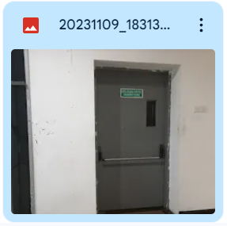
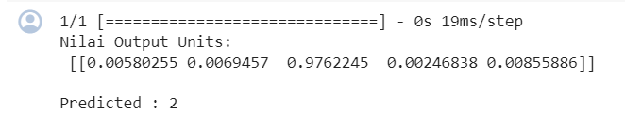

Slide 10
Menentukan nilai output (hasil prediksi). Penentuan kelas yaitu berdasarkan nilai prediksi tertinggi
from keras.preprocessing.image import img_to_array, load_img
import numpy as np
img = load_img(test_dir+'/20231109_183454.jpg', False, target_size=(100,50))
x = img_to_array(img)
x = np.expand_dims(x, axis=0)
preds = model.predict(x)
print("Nilai Output Units:\n", preds)
index_preds = np.argmax(preds)
print("\nPredicted :", index_preds)

Slide 11
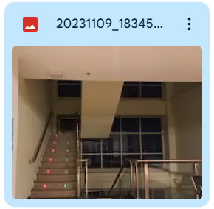
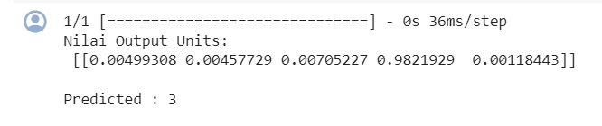

Slide 12
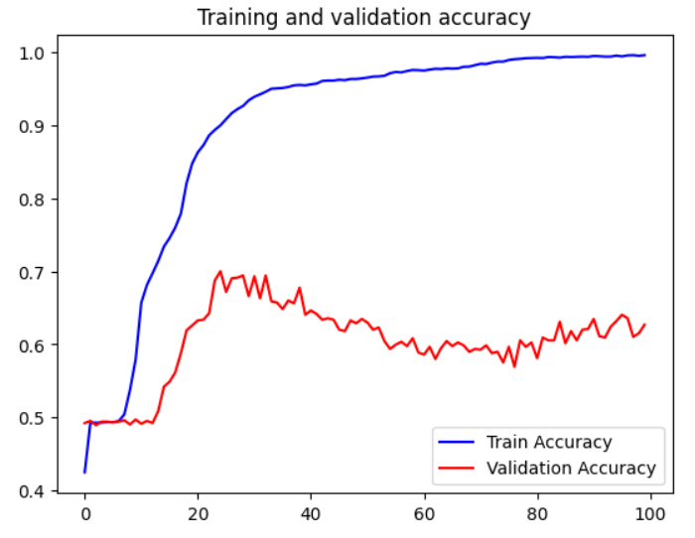
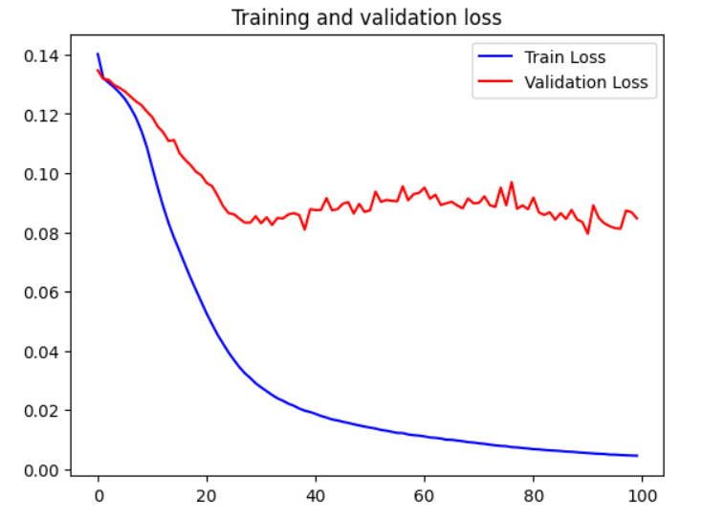
Hasil (Perbandingan dataset sebelumnya dengan dataset saat ini)
Dataset Sebelumnya

Slide 13
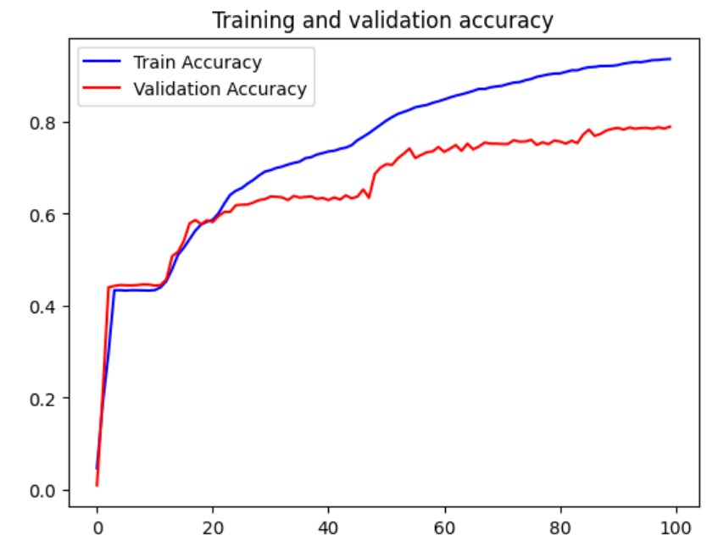
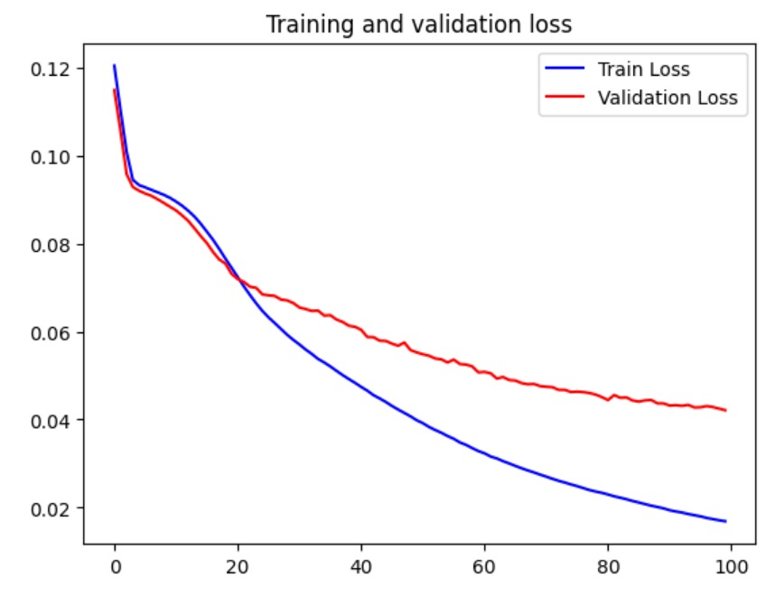
Dataset Kelas

Slide 14
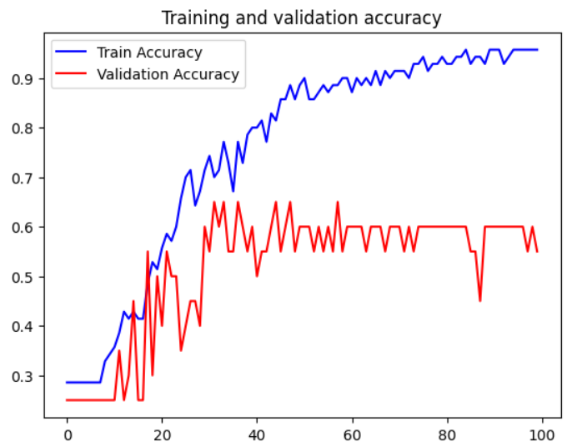
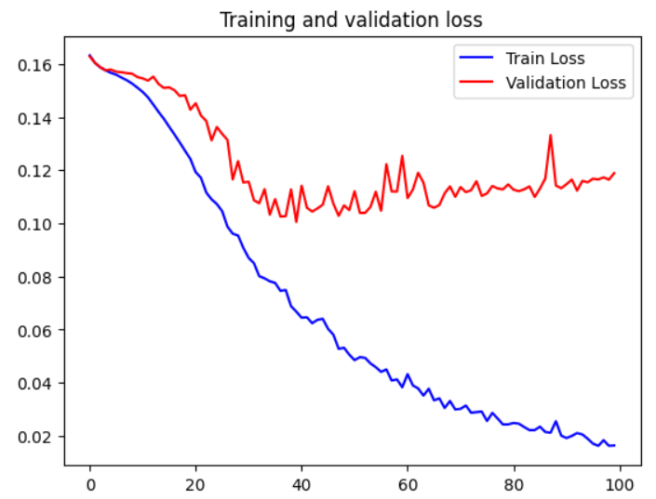
Dataset Kami

Slide 15
Terimakasih

